Slide 1
Regression
And
Interpolation
Course : MATH6183 – Scientific Computing
Year : 2021

Slide 2
Outlines
Linear Interpolation
Polynomial Interpolation
Cubic Spline Interpolation
Least-Square Fit

Slide 3
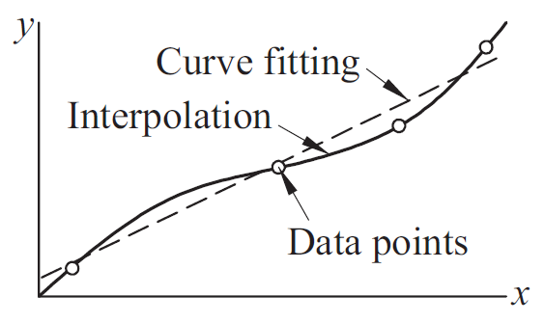
Interpolation VS Curve Fitting
In interpolation we construct a curve through the data points. We make the implicit assumption that the data points are accurate
In contrast, curve fitting is applied to data that contain scatter (noise), caused by measurement errors. Here we want to find a smooth curve that approximates the data in some sense. Thus, the curve does not necessarily hit the data points.
Three attempts to fit a “best” curve through five data points:
(a) Linear Interpolation
(b) Polinomial Interpolation
(c) Curvilinear interpolation.

Slide 4
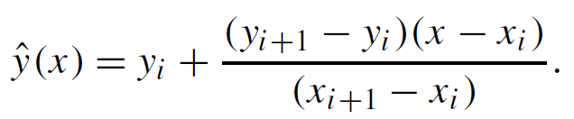
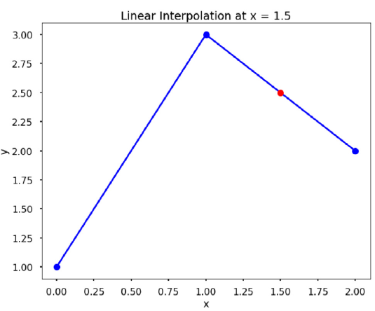

Linear Interpolation
In linear interpolation, the estimated point is assumed to lie on the line joining the nearest points to the left and right. Assume, without loss of generality, that the x-data points are in ascending order, that is, xi <xi+1, and let x be a point such that xi <x <xi+1. Then the linear interpolation at x is
Find the linear interpolation at x = 1.5 based on the data x = [0, 1, 2], y = [1, 3,2].

Slide 5



Newton’s Polynomial Method
Newton’s polynomial interpolation is another popular way to exactly fit a set of data points. The general form of the (n −1)th order Newton’s polynomial that goes through n points is
The special feature of the Newton’s polynomial is that the coefficients ai can be determined using a
very simple mathematical procedure. For example, since the polynomial goes through each data point, for a data point (x_{i}, y_{i} ), we will have f(x_{i} ) = y_{i} , thus we have
If we rearrange it to obtain a₁, we have
If we insert data point (x₂, y₂), we can calculate a₂, and it becomes

Slide 6


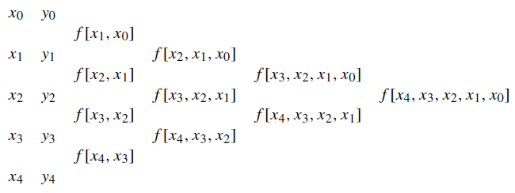
Newton’s Polynomial Method
See the patterns? These are called divided differences. If we define
Then
The advantage of using this method is that once the coefficients are determined, adding new data points will not change the previously calculated coefficient; we only need to calculate the higher differences in the same manner. An example using five data points is shown below

Slide 7

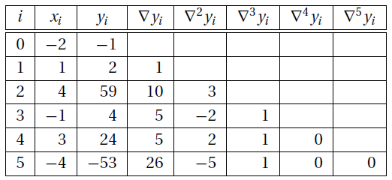
Example 1
The data points
lie on a polynomial. Determine the degree of this polynomial by constructing the divided difference table.
Solution

Slide 8
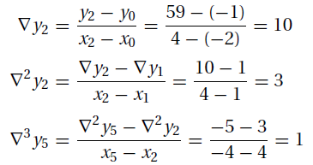
Example 1
Here are a few sample calculations used in arriving at the figures in the table:
From the table we see that the last nonzero coefficient (last nonzero diagonal term) of Newton’s polynomial is ∇³y₃, which is the coefficient of the cubic term. Hence, the polynomial is a cubic

Slide 9
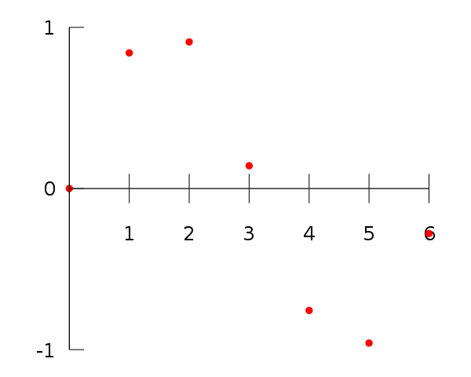
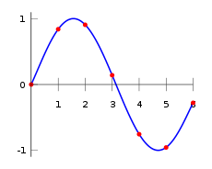
Example 2
For example, suppose we have a table like this, which gives some values of an unknown function f. Interpolation provides a means of estimating the function at intermediate points, such as x = 2.5
x | F(x)
0 | 0
1 | 0.8415
2 | 0.9093
3 | 0.1411
4 | -0.7568
5 | -0.9589
6 | -0.2794
f(x) = -0.001521x⁶ – 0.003130x⁵ + 0.07321x⁴ – 0.3577x³ + 0.2255x² + 0.9038x
Substituting x = 2.5, we find that f(2.5) = 0.5965.

Slide 10
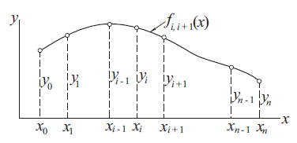

Cubic Spline Interpolation
In cubic spline interpolation the interpolation function is a set of piecewise cubic functions. Specifically, we assume that the points (x_{i}, y_{i}) and (x_{i}+1, y_{i}+1) are joined by a cubic polynomial S_{i}(x) = a_{i}x³ + b_{i}x² +c_{i}x +d_{i} that is valid for x_{i} ≤ x ≤ x_{i}+1 for i = 1, . . . , n−1.
For n points, there are (n−1) cubic functions to find, and each cubic function requires four coefficients. Therefore, a total of 4(n−1) are unknowns, and so we need 4(n −1) independent equations to find all the coefficients.
the resulting curve is known as the natural cubic spline. The pins ( or data points) are called the knots of the spline
If the data points are evenly spaced at intervals h, then x_{i−1} − x_{i} = x_{i} − x_{i+1} = −h

Slide 11
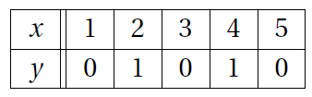
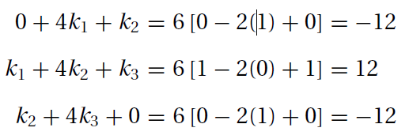

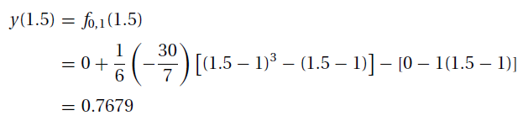
Cubic Spline Interpolation
Use a natural cubic spline to determine y at x = 1.5. The data points are
Solution. The five knots are equally spaced at h = 1. Recalling that the second derivative of a natural spline is zero at the first and last knot, we have k₀ = k₄ = 0. The second derivatives at the other knots are obtained using i = 1, 2, 3 results in the simultaneous equations
The point x = 1.5 lies in the segment between knots 0 and 1. The corresponding interpolant is obtained using
The solution is k₁ = k₃ = −30/7, k₂ = 36/7.

Slide 12
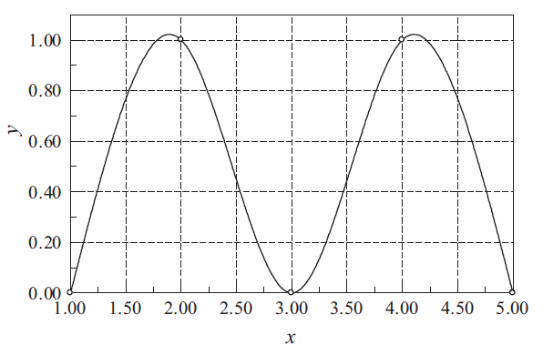
Cubic Spline Interpolation
By solving the equation for even smaller intervals (h=0.5, h=0,25, …), the plot of the interpolant, which in this case is made up of four cubic segments could be discretely shown as

Slide 13


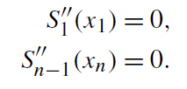
Cubic Spline Interpolation
If the data points are not evenly spaced, we need 4(n-1) independent equations to find all the coefficients. First, the cubic functions must intersect the data the points on the left and the right:
which gives us 2(n−1) equations. Next, we want each cubic function to join as smoothly with its neighbors as possible, so we constrain the splines to have continuous first and second derivatives at the data points i = 2, . . . , n −1:
which gives us 2(n −2) equations. Two more equations are required to compute the coefficients of Si(x). These last two constraints are arbitrary; A common set of final constraints is to assume that the second derivatives are zero at the endpoints. This means that the curve is a “straight line” at the end points. Explicitly,

Slide 14
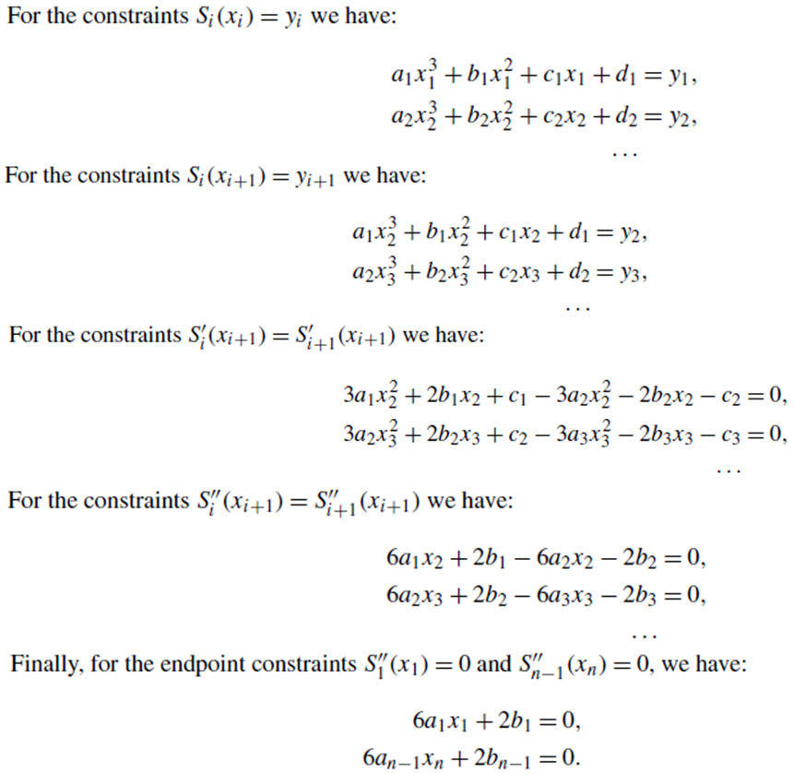
Cubic Spline Interpolation

Slide 15
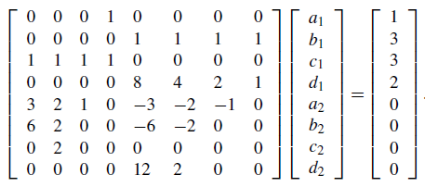
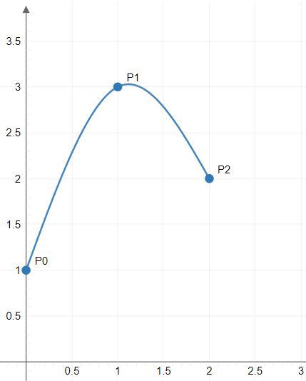
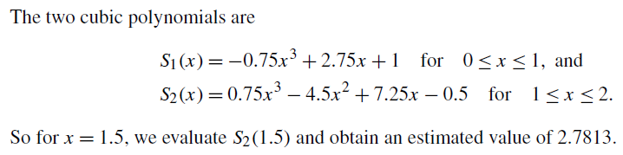
Cubic Spline Interpolation
Find the cubic spline interpolation at x = 1.5 based on the data x = [0, 1, 2], y = [1, 3, 2]. First, we create the appropriate system of equations and find the coefficients of the cubic splines. The easier way to show and solve the system is using matrix form.

Slide 16


Least-Squares Fit
Let be the function that is to be fitted to the n + 1 data points (x_{i} , y_{i} ), i = 0,1, . . ,n. The notation implies that a function of x contains m+ 1 variable a₀,a₁,. . . ,a_{m}, where m < n. The form of f (x) is determined beforehand, usually from the theory associated with the experiment from which the data are obtained.
Curve fitting consists of two steps: choosing the form of f (x), followed by computation of the parameters that produce the best fit to the data.
What is meant by “best” fit? If the noise is confined to the y-coordinate, the most commonly used measure is the least-squares fit, which minimizes the function
The terms r_{i} = y_{i} − f (x_{i} ) are called residuals

Slide 17


Least-Squares Fit
Therefore, the optimal values of the parameters are given by the solution of the equations
The function S to be minimized is thus the sum of the squares of the residuals. Often the fitting function is chosen as a linear combination of specified functions f_{j} (x):
in which case Eqs. (*) are linear. If the fitting function is a polynomial, we have f₀(x) = 1, f₁(x) = x, f₂(x) = x², and so on.
The spread of the data about the fitting curve is quantified by the standard deviation, defined as

Slide 18

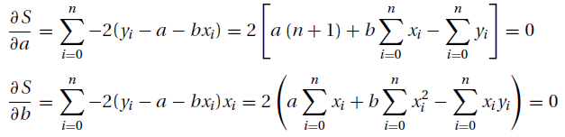

Fitting A Straight Line
Fitting a straight line f (x) = a +bx to data is also known as linear regression. In this case, the function to be minimized is
The optimal values of the parameters are given by the solution of the equations
Dividing both equations by 2 (n + 1) and rearranging terms, we get

Slide 19



Fitting A Straight Line
Where,
are the mean values of the x and y data. The solution for the parameters is
These expressions are susceptible to roundoff errors (the two terms in each numerator as well as in each denominator can be roughly equal). It is better to compute the parameters from

Slide 20






Example 3
Fit a straight line to the data shown
and compute the standard deviation.
Solution
The intercept a and slope b of the interpolant can now be determined from
the regression line is f (x) = 2.927 + 0.6431x, which is shown in the figure
together with the data points.

Slide 21
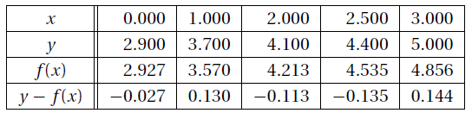

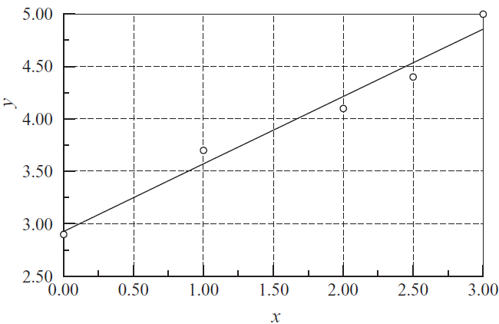

Exercise 3
We start the evaluation of the standard deviation by computing the residuals:
The sum of the squares of the residuals is
so that the standard deviation becomes

Slide 22

Example 3
Use linear regression to find the line that fits the data
and determine the standard deviation.

Slide 23


Example 4
Determine the parameters a and b so that fits the following data in the least-squares sense.
fit ln yi and
Compute the standard deviation in this case.
Solution :
(1) The problem is to fit the function ln( ) = lna +bx to the data
We are now dealing with linear regression, where the parameters
to be found are A = lna and b.

Slide 24


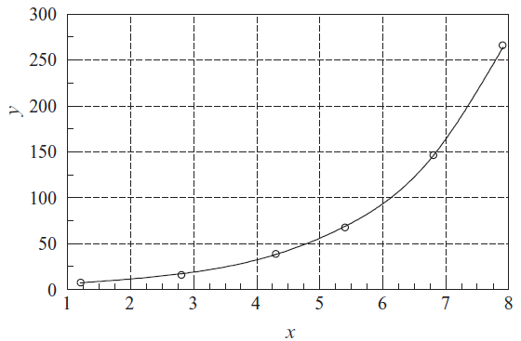

Example 4
We get
Therefore, a = = 3.790
and the fitting function
becomes
The plots of f (x) and the data
points are shown in the figure.

Slide 25
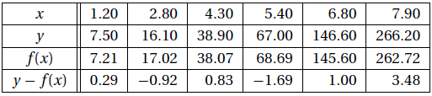
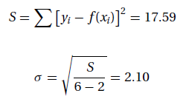
Example 4
(2). Here is the computation of standard deviation:
As pointed out before, this is an approximate solution of the stated problem, because we did not fit yi, but ln yi . Judging by the plot, the fit seems to be quite good.

Slide 26
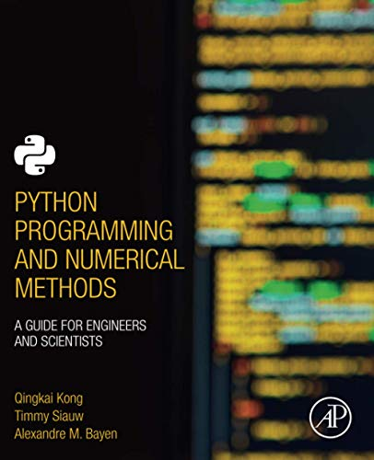
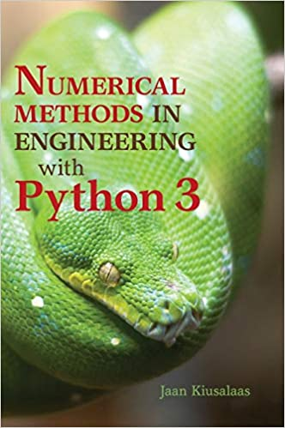
These slides have been adapted from: Kong, Q., Siauw, T., & Bayen, A. M. (2021). Python Programming and Numerical Methods: A Guide for Engineers and Scientists. Academic Press. ISBN: 978-0-12-819549-9 Kiusalaas, J. (2013). Numerical Methods in Engineering with Python 3. United Kingdom: Cambridge University Press. ISBN:9781107033856 Additional materials : Chapra, S.C (2015). Numerical Methods for Engineers. 6st Edition. McGraw-Hill Companies, Inc . New York. ISBN. 978-981-4670-87
Acknowledgement

